Slide 1
Cyber Security : Lecture 09
By
Prof.Neha S.Sakhalkar

Slide 2
Botnets

Slide 3
Bot
Dictionary meaning :
Automated program for doing particular task often over a network

Slide 4
Botnet
Collection of software roBots
OR
Number of Internet-connected devices, each of which is running one or more bots.
Often associated with malicious software but can also refer to network of computers using distributed computing software

Slide 5
Properties of Botnet
Runs automatically and autonomously
Your computer appears to operate normally even if it is a part of Botnet

Slide 6
What Botnet Attacks Include
Botnets are often used to conduct a range of
activities which include
Send spam
Send viruses
Steal data
DoS
DDoS

Slide 7
What Botnet Attacks Include
Botnet
Creation
Renting
DDoS Attacks
Phishing Attacks
Spamdexing
Selling
Spam attacks
Stealing confidential Information
Malware and Adware

Slide 8
What Botnet Attacks Include
Botnet
Creation
Renting
DDoS Attacks
Phishing Attacks
Spamdexing
(Search Engine Spam)
Selling
Spam attacks
Stealing confidential Information
Malware and Adware

Slide 9
Botnet Architecture
Botnet structures have three parts:
Bot, Botmaster, command and control channel.

Slide 10
Botnet Architecture
Bot
A Bot, emanating from the term ‘Robot’

Slide 11
Botnet Architecture
Bot
A Bot, emanating from the term ‘Robot’
It is a new type of malware installed into a compromised
computer which can be controlled remotely by Botmaster for
carrying out some orders through the received commands

Slide 12
Botnet Architecture
Bot
A Bot, emanating from the term ‘Robot’
It is a new type of malware installed into a compromised
computer which can be controlled remotely by Botmaster for
carrying out some orders through the received commands
Bot Vs Virus/Worms
The difference between the Botnet and the virus is whether it can be
controlled or not
Contrary to existing malware such as virus and worm which their main
activities focus on attacking the infecting host, Bots can receive commands
from Botmaster and are used in distributed attack platform.

Slide 13
Botnet Architecture
Botmaster
Botmaster is known as Botherder that is a person or a group of
person which control and manage remote Bots and Botnet.

Slide 14
Botnet Architecture
Command and Control Channel
Botnet use the command and control channel to control the Botnet.

Slide 15
Botnet Architecture
Command and Control Channel
Botnet use the command and control channel to control the Botnet.
The most essential part of a Botnet is the so called command and control infrastructure (C&C).

Slide 16
Botnet Architecture
Command and Control Channel
Botnet use the command and control channel to control the Botnet.
The most essential part of a Botnet is the so called command and control infrastructure (C&C).
This infrastructure consists of the Bots and a control entity that can be either centralized or distributed.

Slide 17
Botnet Lifecycle
Spreading and Injection
The lifecycle of a Botnet begins with the infection process where the Botmasters use different methods and techniques such as malicious emails, Software vulnerability instant messaging to infect new targets and convert them into Bots

Slide 18
Botnet Lifecycle
B. Communications stage
The main difference between Botnet and other kind of malwares is the existence of Command-and-Control (C&C) infrastructure.

Slide 19
Botnet Lifecycle
B. Communications stage
The main difference between Botnet and other kind of malwares is the existence of Command-and-Control (C&C) infrastructure.
The C&C allows Bots to receive commands and malicious capabilities, as devoted by Botmaster.

Slide 20
Botnet Lifecycle
B. Communications stage
The main difference between Botnet and other kind of malwares is the existence of Command-and-Control (C&C) infrastructure.
The C&C allows Bots to receive commands and malicious capabilities, as devoted by Botmaster.
In other words during this stage the Bots listen to the C&C servers or connect to them periodically to get new commands from the Botmaster.

Slide 21
Botnet Lifecycle
B. Communications stage
The main difference between Botnet and other kind of malwares is the existence of Command-and-Control (C&C) infrastructure.
The C&C allows Bots to receive commands and malicious capabilities, as devoted by Botmaster.
In other words during this stage the Bots listen to the C&C servers or connect to them periodically to get new commands from the Botmaster.
A new command when detected by the Bots is treated as an order: they execute the order and the results are reported to the C&C server; the Bots then wait for new commands.

Slide 22
Botnet Lifecycle
C.Attack stage
The final goal of a Botnet is the execution of an attack.
The Bots start to attack the targets according to the accepted
commands.
Sometimes, the Bots connect to a specially appointed server for
the latest updates.

Slide 23
Botnet Lifecycle
C.Attack stage
Includes
DDoS
Spaming
Thieving Personal information
Illegal hosting,renting and selling
Click fraud and adware
Trojans
Viruses
Worms

Slide 24
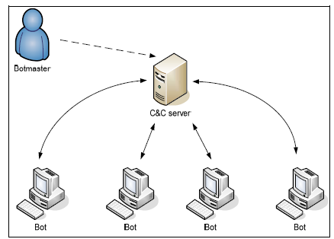
Botnet Architectures
Centralized

Slide 25
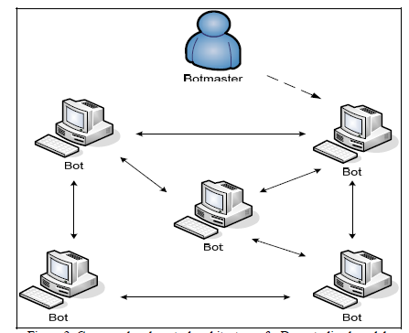
Botnet Architectures
DeCentralized

Slide 26
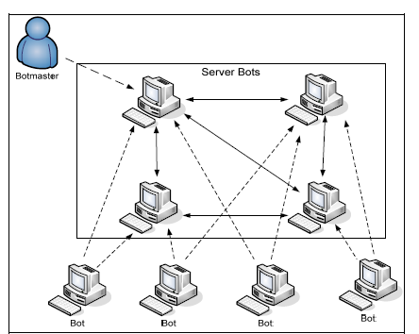
Botnet Architectures
Hybrid

